Slide 1


Slide 2
Introduction to Information Systems

Slide 3
Overview
In this module you will learn:
How to define an information system (IS)
Some examples and types of IS
How to use the concepts of systems theory to explain the parts and behaviour of IS
How IS can be useful in managing organizations
Project Management Concepts
Project Issues
Ethics

Slide 4
Introduction
Information Systems (IS) are created by people, and exist across all industries and organizations.
All IS must be able to select, store, process and retrieve relevant data.
IS do not necessarily depend on computers (ours will). They are more about process and information.

Slide 5
IS in History
IS have existed in some form throughout history:
Ancient Mesopotamian records of grain in city storehouses (3500 BCE)
Roman Empire records of property and tax
19th Century railway signalling systems
The RAF’s communication and control system used during the Battle of Britain(1940)

Slide 6
The Emergence of Modern IS
Most IS today depend on digital electronic computers
Very few industries are at least partially IT
Earliest examples (in Second World War) include code-breaking Colossus Computer
First business computer, Leo 1, built in 1951, used for routine transactions like payroll and managing inventory
Modern IS used for vast range of purposes

Slide 7
The Role of the Computer
Computers carry out tasks done by people and by technologies
Storage: accounting ledger / hard disk
Display: Battle of Britain map / PC screen
Calculation: abacus / software program
Communication: traffic signals / wifi
Typical advantages of computers:
high speed, low cost, reliability

Slide 8
Amazon On-Line Retail Site
A typical modern IS with:
Online catalogue display and shopping cart
Back-office systems store stock details, orders, payment transactions, and more
Communications link to credit-card processing centre
Robot warehouse control system
Delivery scheduling

Slide 9
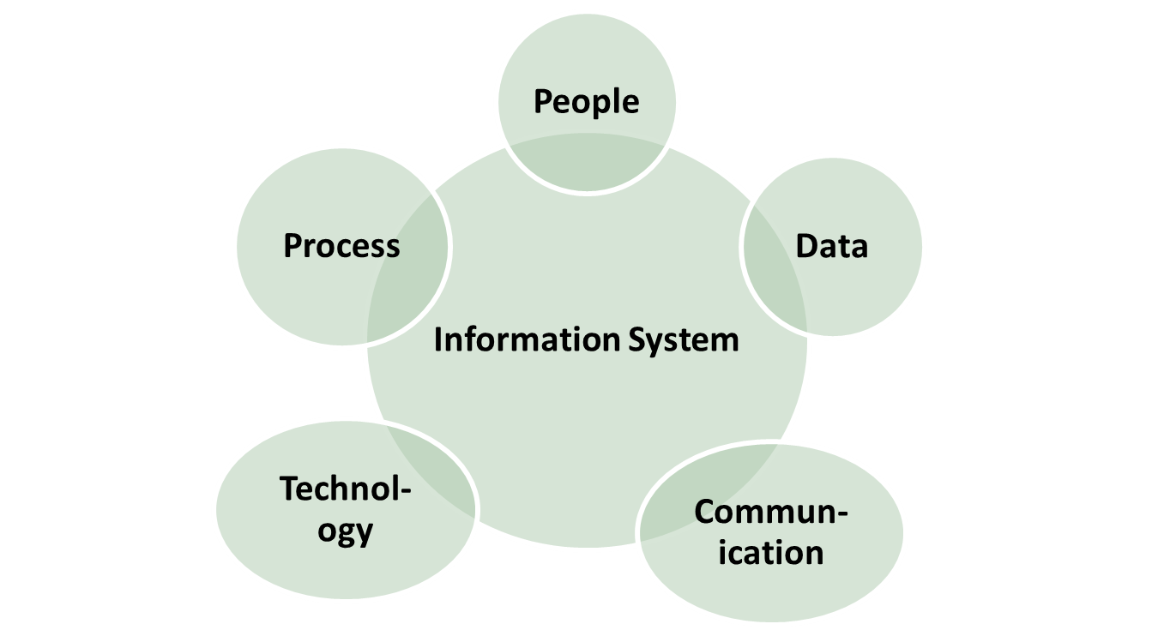
Structure of an IS

Slide 10
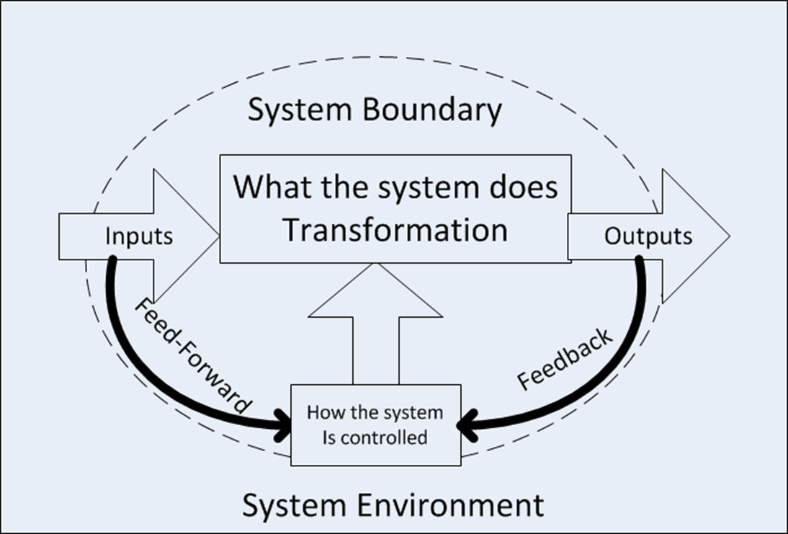
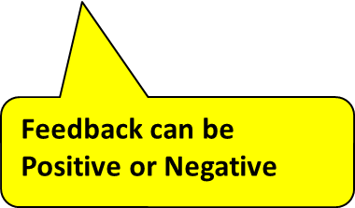
An IS is a System

Slide 11
Characteristics of Systems
Every system has:
Inputs and outputs
A purpose (what the system does)
A boundary (resources assigned to the IS)
An environment (where the IS runs)
Subsystems and interfaces (connectors for supporting IS systems/subsystems)
Control using feedback and feed-forward
Some emergent property (system is more than the sum of its parts)

Slide 12
Examples of Feedback
Feedback may be positive or negative. The results may be positive or negative respectively, however, this feedback may have the opposite desired effect
Positive and negative examples would be adding or removing money from a bank account.
A negative feedback from a thermostat (for example turning it off) may set the proper temperature
A positive feedback such as additional data collected in a data collection system may overwhelm the system, resulting in a failure or loss of data

Slide 13
System Transformation
All useful systems transform their inputs into useful outputs
For IS, inputs are typically data or information and outputs are typically also information
This transformation is the whole reason for building and operating the system
It must render the input data useful in some new way

Slide 14
Transformation Example
Amazon’s online system may have inputs:
Information about orders, available stock, customer addresses, delivery rates…
It may have outputs:
Electronic content delivered to Kindles, shipping labels, gift certificates, emails…
How does this benefit Amazon?

Slide 15
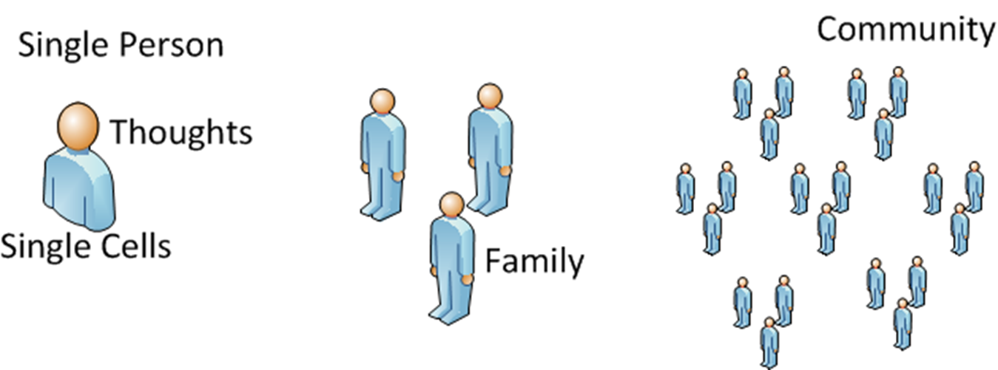
Systems and Subsystems

Slide 16
Systems in a typical car (2018)
- the PCM which is the main computer that communicates with all the other computers. - an Engine Control Module (ECM) - an emissions computer - a computer chip in the radio - body control computers somewhere in the back - a computer chip in the HVAC system - a computer chip in the clock - a computer for the ABS brakes - a computer in the electrically assisted steering system - airbag computer - a computer in the GPS system - a fuel mileage computer - a computer for the BLUETOOTH system - a chip in the auto headlamp system - a chip in the DVD player - and then there is the remote start - and the anti theft system

Slide 17
Types of IS
Operational Systems assist or control business operations
Amazon may use a barcode system with readers to ensure boxes are loaded and shipped
Management Support Systems help managers to decide or to communicate
Amazon will use inventory tracking software to check the performance of products, and adjust prices and inventory accordingly

Slide 18
Types of IS (cont’d)
Real-time Control Systems typically operate physical equipment, often in safety-critical settings
Some cars have an Engine Management System to control fuel supply and ignition
Satellite control systems
Missile guiding systems
3D printers

Slide 19
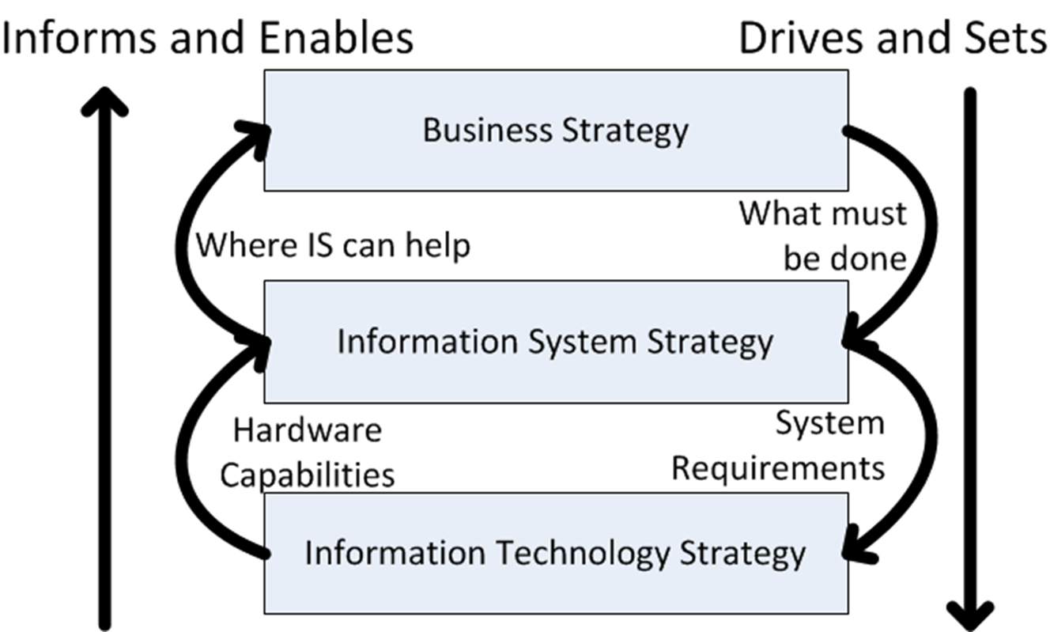
Multiple Strategies for IS and IT

Slide 20
IS/IT Strategy
Information Systems and Technology should be utilized as part of an organization’s overall business strategy and should be designed to support the organization’s overall business plan

Slide 21
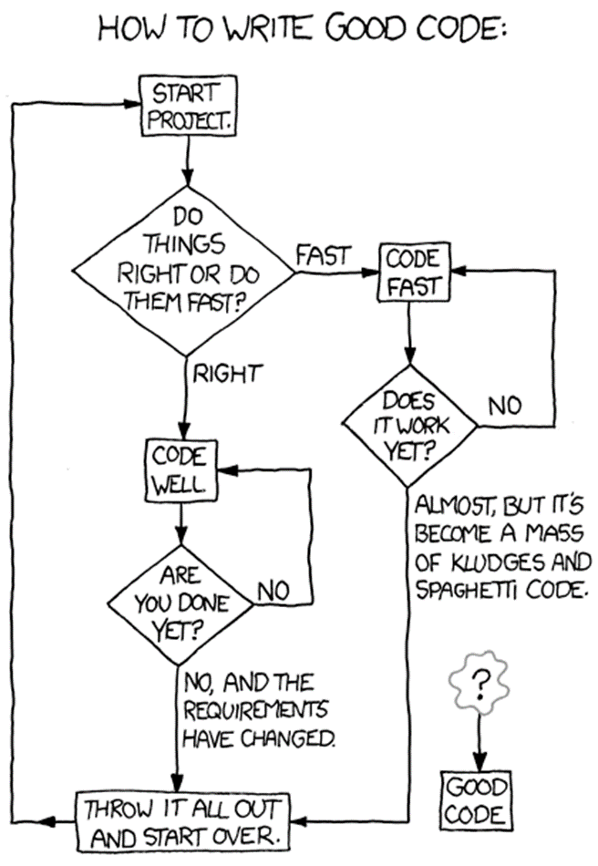
Systems Development is a Journey
Many possible routes
Developers need guidance
From xkcd.com

Slide 22
Costs of Failure
These can be very high indeed
Initial rollout of Obama Care system https://en.wikipedia.org/wiki/Patient_Protection_and_Affordable_Care_Act#Implementation
One survey shows up to 2 projects in 3 are unsuccessful in the USA (Standish 2009)
Another survey found less than 50% of UK projects met expectations (Veitch 2007)

Slide 23
What Do We Mean by Problem?
An IS project may fail before delivery
Avon’s failed SAP implementation in Canada
An IS may fail after delivery
Canadian Firearms Registry was cancelled after implementation, sighting cost overruns and problems – potential political decisions as well
Phoenix Pay System – Project was simply too focused on delivering the project on time and on budget resulting in dropping a lot of functions that were important to Phoenix.
An IS may be continue to be used, despite causing problems to its users, its owners or its developers

Slide 24
Stakeholder
A Stakeholder, or project stakeholder, is anyone that has an interest in a given project. These stakeholders may be inside or outside an organization which:
Sponsor a project, or
Have an interest or a gain upon a successful completion of a project;
May have a positive or negative influence in the project completion.
Stakeholders may be customers, users, project managers, project team members, testers, etc

Slide 25
The Main Players
Three main types of stakeholder are involved in an IS development project:
Those who will benefit from the system’s outputs, directly or indirectly (end-users)
Those who commission the project, pay for it or have the power to halt it (owners or sponsors)
Those who will produce the software (developers)

Slide 26
End-user View
End-users may be those who directly operate the software
Or they may be more remote, e.g. a manager who receives printed reports
Typical concerns include:
A system that is promised but not delivered
A system that is difficult to use
A system that doesn’t meet its users’ needs

Slide 27
End-user View (cont’d)
Systems that are hard to use may be seen as a failure by their users
Unhelpful error messages are just one of the ways a system can be hard to use
When some computer systems are powered on, they will issue a series of beeps to indicate a problem (POST Beeps). For the average user, this is useless information
Windows Blue Screen of Death, Check Engine light in a vehicle.

Slide 28
Owner View
Owners care about meeting business needs and about value for money
Typical concerns include:
Projects that overspend their budget (may no longer have a net benefit)
Systems that are delivered too late
Badly managed projects
Systems that are rendered irrelevant by events

Slide 29
Developer View
IS developers sometimes have a difficult time
Budget and time constraints often conflict with doing the job properly
Users and owners may not know how to ask for what they really want
Technologies, development approaches and business needs all constantly change

Slide 30
Why Things Go Wrong
Whether a system is delivered or not, many things can go wrong:
Quality problems
Productivity problems
Installation & Operation problems

Slide 31
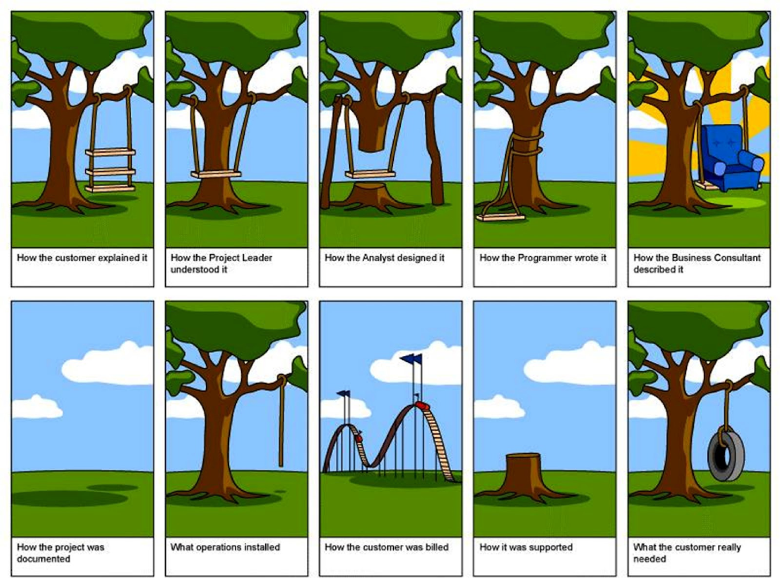

Slide 32
1 - Quality Problems
The wrong problem is addressed
Failure to align the project with business strategy
Neglect of the context
Project team or business managers don’t take the system environment into account
Incorrect analysis of requirements
Poor skills or not enough time allowed
Project undertaken for wrong reason
Technology pull or political push

Slide 33
2 - Productivity Problems
Users change their minds
“Requirements Drift” aka “Scope Creep”
External events
E.g. introduction of the Euro currency
Implementation not feasible
This may not be known at start of the project
Poor project control
Inexperienced management or political difficulties

Slide 34
3 – Installation & Operation
Poor Installation
Failure to follow required specifications
Operational issues
Poor response times; Disconnected services
Poor maintenance documentation
Out of date checklists; performing shortcuts outside documentation
Local resistance to new IS
Poor communication about IS; limited or no training of users

Slide 35
Ethics Issues and Stakeholder Problems
Some IS may affect people far beyond obvious users and owners of the system
Cell phone companies collect data about subscribers’ calls and physical movements
This data can be passed to police and many other government agencies
Do you know what data is stored about you? Who by? And what it is used for?

